Slide 1
Pokédex
created by Gaetano Panzer II

Slide 2
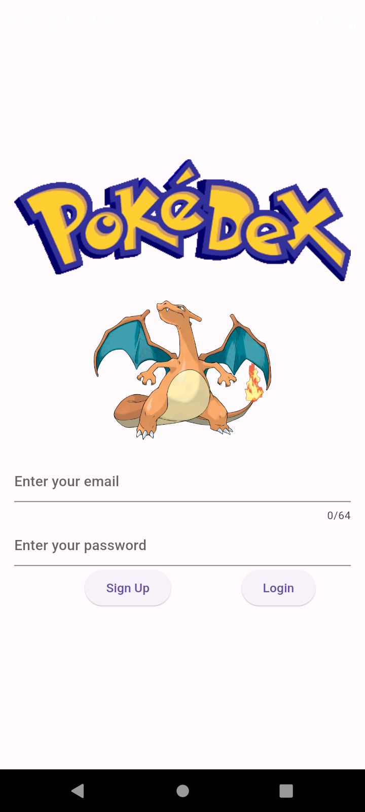
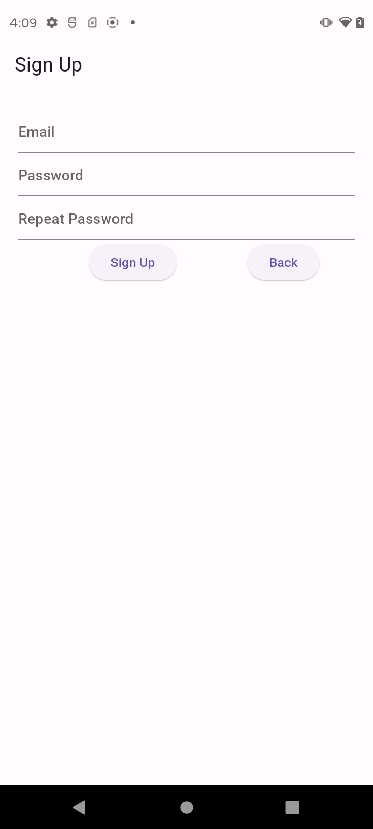
Login page on the left prompts users to sign into their account or sign up. The signup button will take you to the sign up page, displayed on the right.

Slide 3
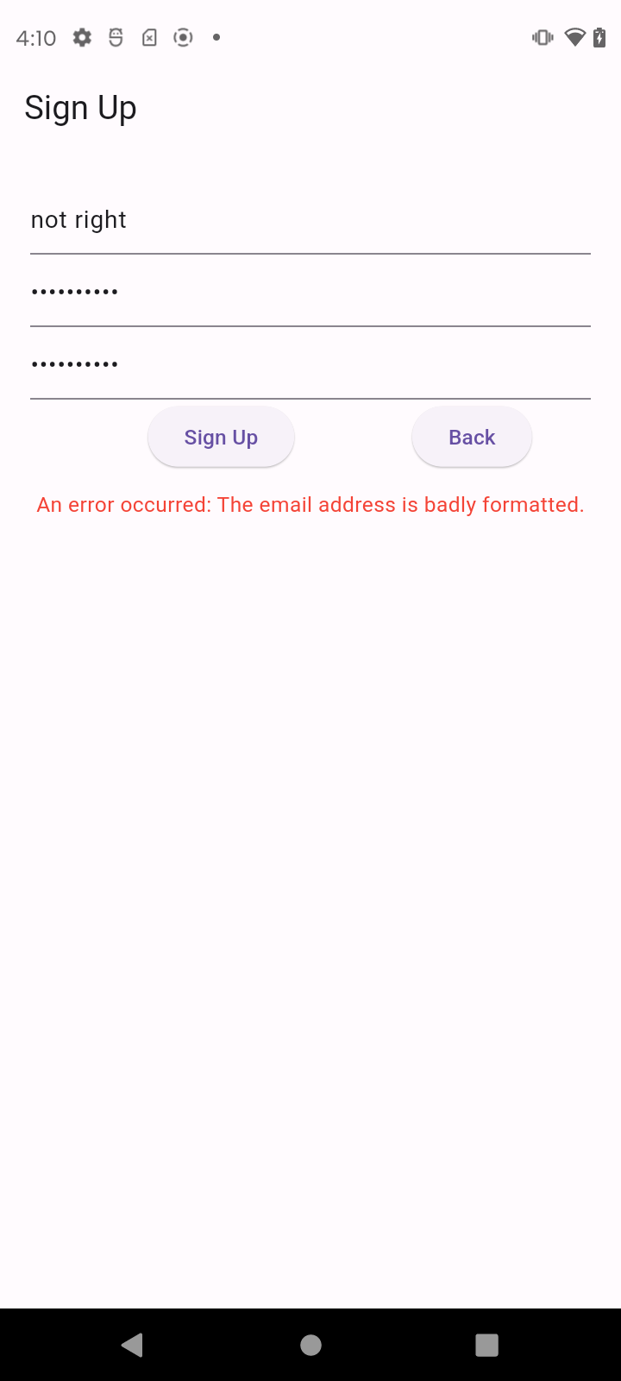
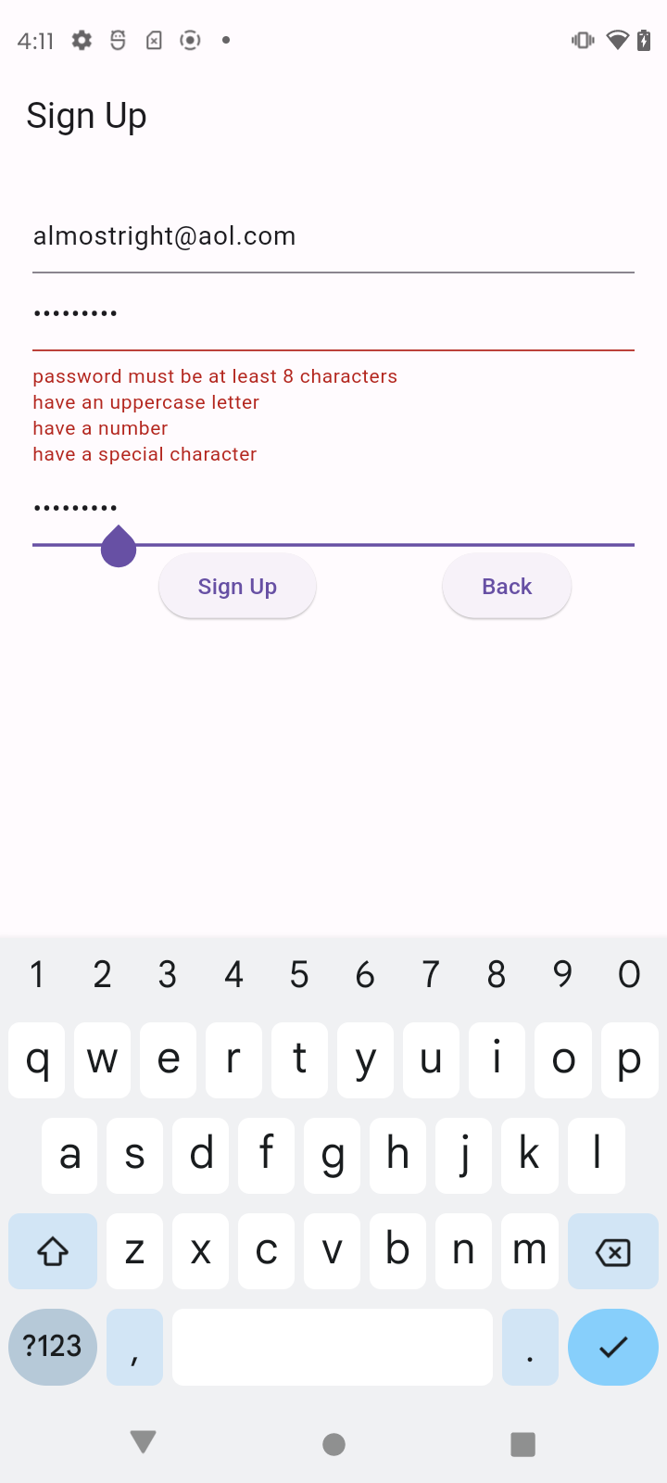
Emails must be formatted correctly and passwords must secure. This is ensured by requiring a minimum of eight characters, an uppercase and lowercase letter, a number and a special character.
Firebase adds users to the database once all fields are accepted.

Slide 4
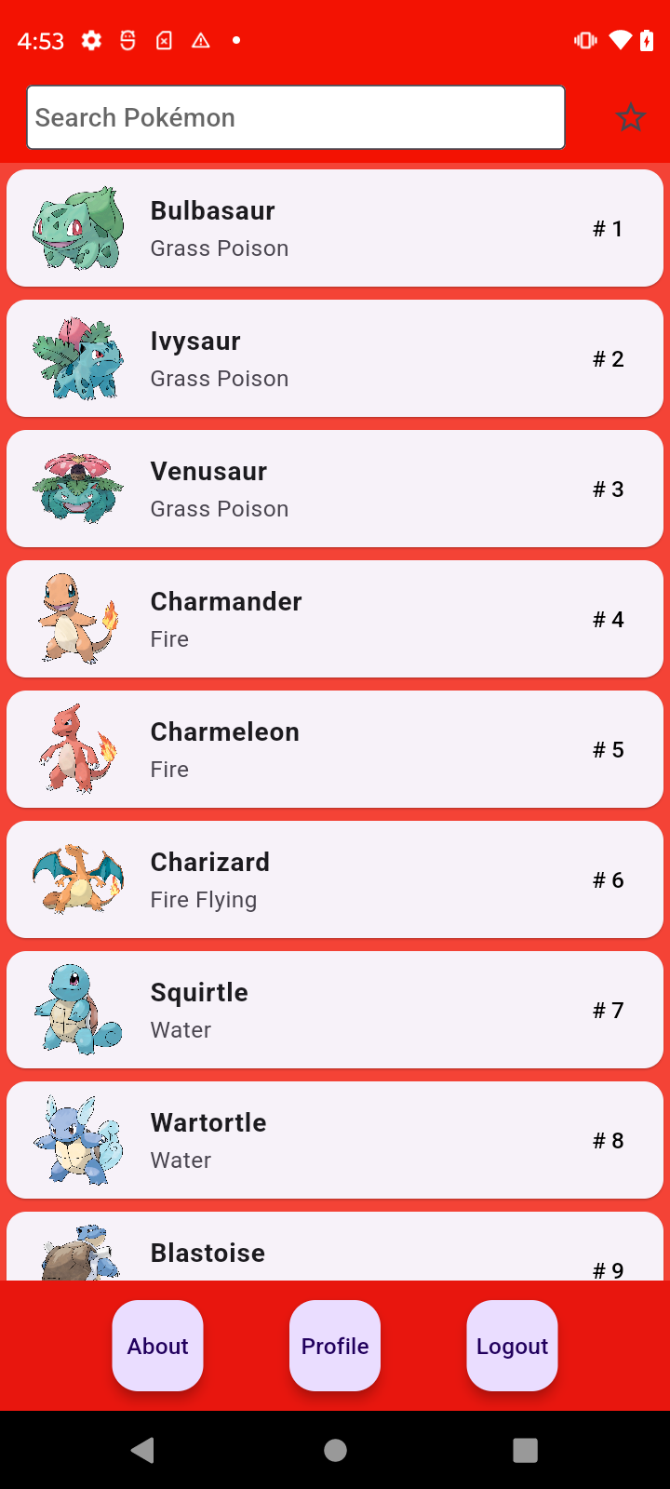
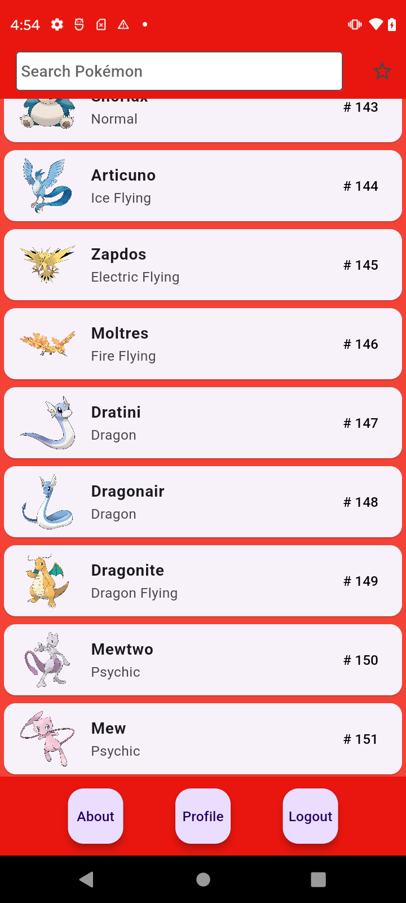
The main page will show all 151 of the original Pokémon.
Each Pokémon displays their name, types, number and image - which is all stored in a Firebase collection. They can also be clicked on the open a new page with more information.
About - takes users to a page where they can see the author of the app. Me.
Profile - takes users to a page where they can take a profile picture or choose one from their library
Logout - logs the user out of their account so another user can sign in.

Slide 5
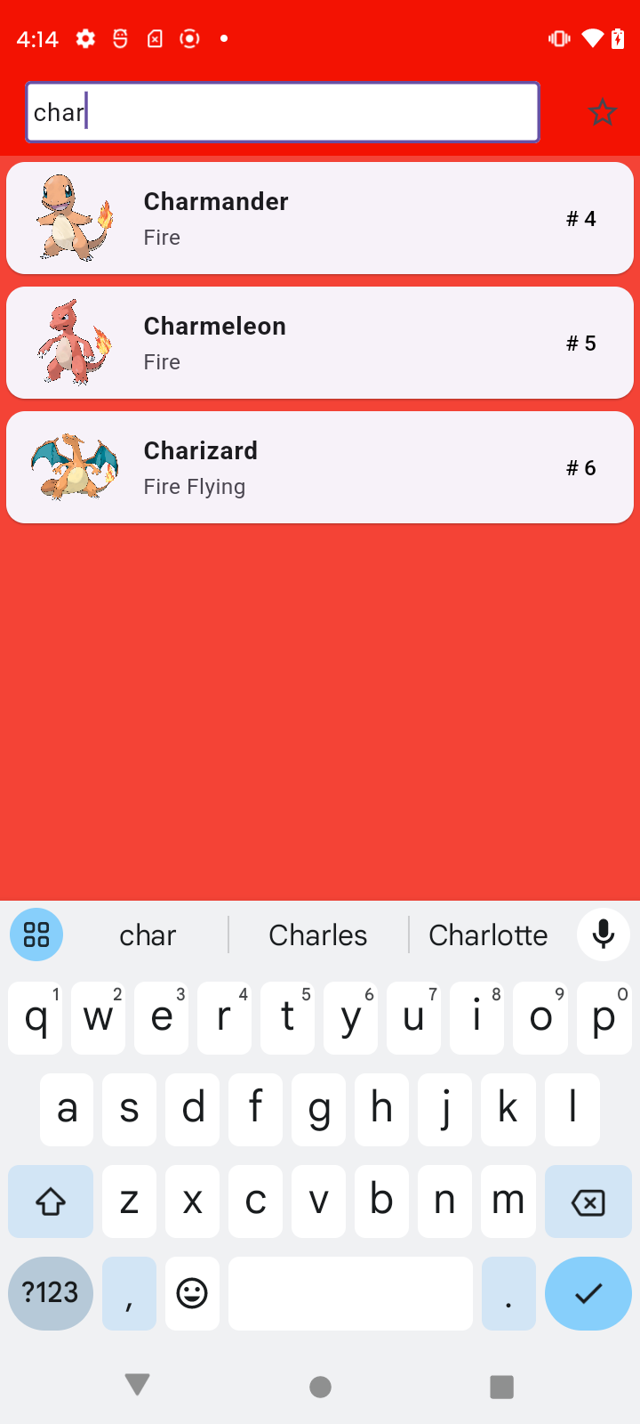
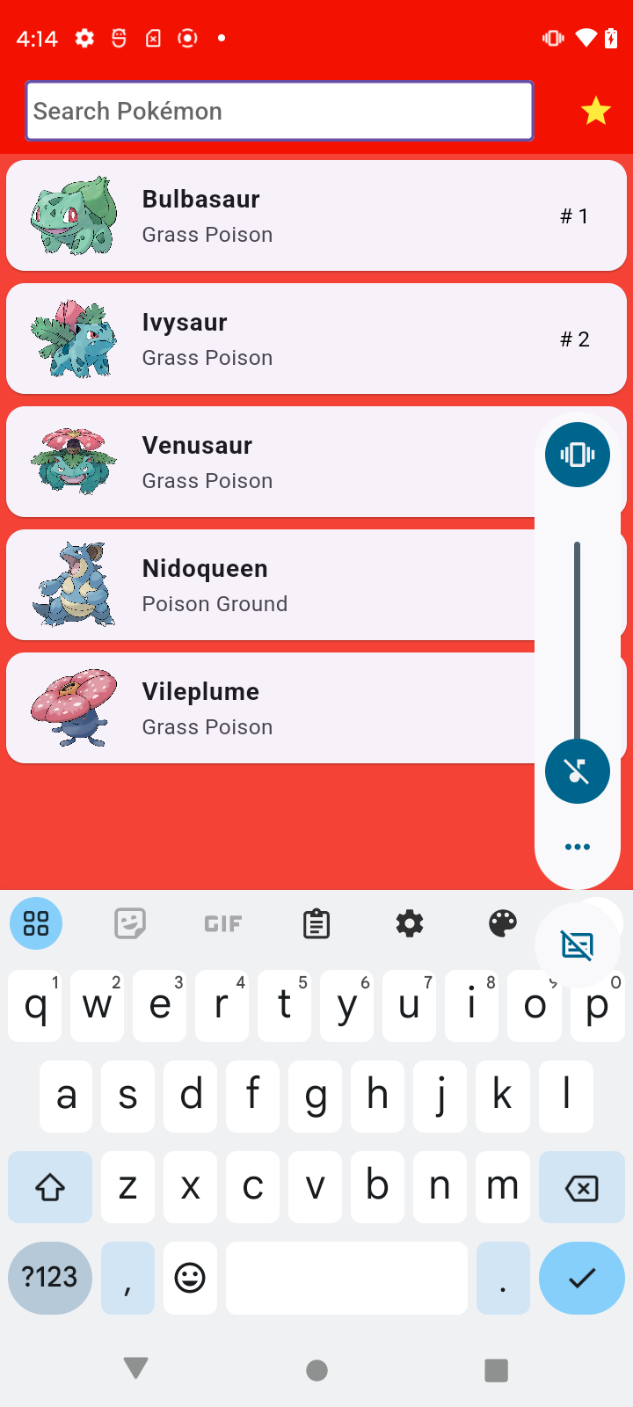
The yellow star can be hit to display all your favorited Pokémon.
The search bar will work with the list of favorites only if this option is selected.
The search bar allows for searching any pokemon with that string of characters in their name.

Slide 6
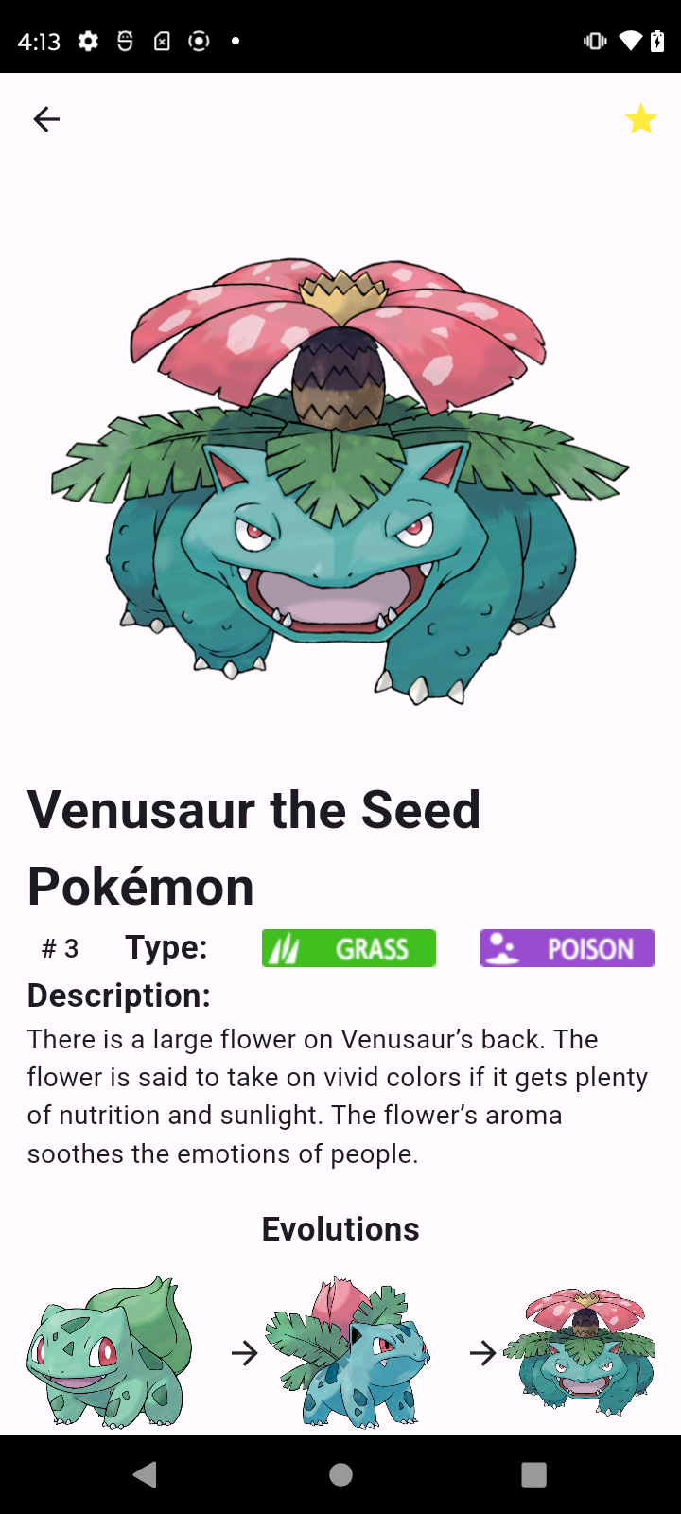
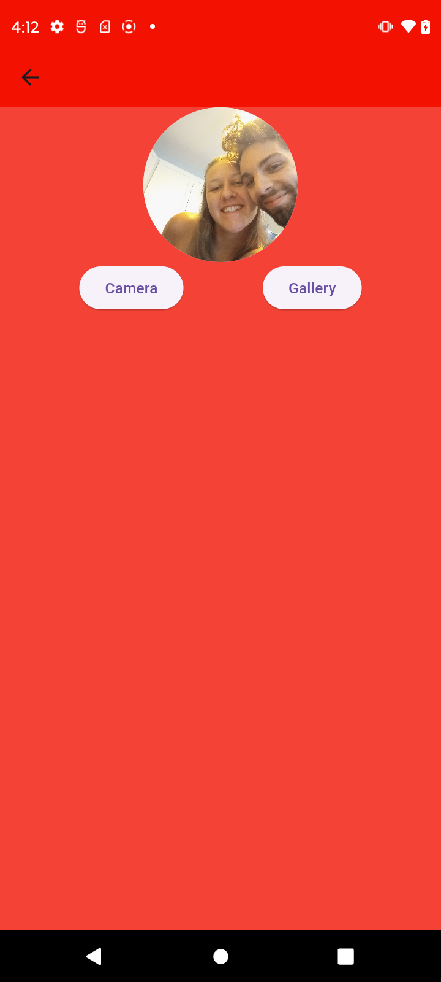
The star can be selected on this page to favorite a Pokémon. As shown in the previous slide, this is to make them easier to find on future visits.
Users can hit back arrow to return to the full Pokémon list. The species of the Pokémon, a more colorful depiction of their type, a description of the Pokémon and their evolutionary line will be displayed on this page as well. All pulling from the same collection in Firebase.
Profile photo can be selected and updated on this page to give users a more personalized experience.

